Slide 1


DANBI: Dynamic Scheduling of Irregular Stream Programs for Many-Core Systems
Changwoo Min and Young Ik Eom
Sungkyunkwan University, Korea
DANBI is a Korean word meaning timely rain.
Notes:
Hello everyone.
I am Changwoo Min from Sungkyunkwan University in Korea.
Today, I am going to talk about our work on, “DANBI: Dynamic Scheduling of Irregular Stream Programs for Many-Core Systems”.
“DANBI” is a Korean word meaning “timely rain”.
We picked it as the project name for its nature of dynamic resource scheduling.

Slide 2
What does Multi-Cores mean to Average Programmers?
In the past, hardware was mainly responsible for improving application performance.
Now, in multicore era, performance burden falls on programmers.
However, developing a parallel software is getting more difficult.
Architectural Diversity
Complex memory hierarchy, heterogeneous cores, etc.
Parallel Programming Models and Runtimes
e.g., OpenMP, OpenCL, TBB, Cilk, StreamIt, …
Notes:
Let’s think about what does multi-core means to average programmers?
In the past, hardware was mainly responsible for improving application performance.
But, now in multi-core era, performance burden falls on programmers.
However, developing a parallel software is getting more difficult, because of the architectural diversity of modern multicore systems.
Modern multicore processors adopt complex memory hierarchy to hide communication cost. Moreover, some architectures adopt heterogeneous cores to reduce power consumption.
Due to this technical trends, many parallel programming models and runtimes have been proposed.

Slide 3
Stream Programming Model
A program is modeled as a graph of computing kernels communicated via FIFO queue.
Producer-consumer relationships are expressed in the stream graph.
Task, data and pipeline parallelism
Heavily researched on various architectures and systems
SMP Core, Tilera, CellBE, GPGPU, Distributed System
Data
Parallelism
Producer Kernel
Consumer Kernel
Task
Parallelism
FIFO Queue
Pipeline
Parallelism
Notes:
Among the parallel programming models, our interest is on the stream programming model.
In the stream programming model, a program is modeled as a graph of computation kernels connected via data queues.
Since producer-consumer relationships are naturally expressed in the stream graph, there is opportunity for a scheduler to generate more efficient schedules by exploiting the producer-consumer relationships.
<CLICK> Moreover, we can express <CLICK> task, <CLICK> data, and <CLICK> pipeline parallelism by using the stream programming model.
<CLICK> Due to such advantages, the stream programming model has been heavily researched and extensively adopted in many architectures including SMP cores, GPGPUs and distributed systems.

Slide 4
Research Focus: Static Scheduling of Regular Programs
Scheduling & Execution
Programming Model
Compiler
Runtime
1. Estimate work for each kernel
3. Iteratively execute the schedules with barrier synchronization
Input/output data rates should be known at compile time.
Cyclic graphs with feedback loops are not allowed
1:3
1:1
2. Generate optimized schedules based on the estimation
1:2
Barrier |
Core | 1 2 3
BUT, replying on the accuracy of the performance estimation → load imbalance
Accurate work estimation is difficult or barely possible in many architectures.
BUT, many interesting problem domains are irregular with dynamic input/output rates and feedback loops.
Computer graphics, big data analysis, etc.
Notes:
Until recently, the research focus has been on static scheduling of regular programs.
<CLICK> In terms of programming model, regular program has two restrictions.
<CLICK> First one is input/output rate of data queue should be known are compile time.
<CLICK> And second, they do not support cyclic graph with feedback loops.
<CLICK> However, these are quite serious limitations because many interesting problem domains, such as computer graphics and big data analysis, are irregular with dynamic input/output rates and feedback loops.
<CLICK> In terms of scheduling and execution,
stream compiler <CLICK> first estimates how long each kernel takes and then <CLICK> generates pre-computed schedules based on the estimation.
<CLICK> Runtime simply executes the statically generated schedules iteratively with barrier synchronization.
<CLICK> However, scalability of such systems rely on the accuracy of the estimation.
If it is inaccurate, it will suffer from load imbalance.
Unfortunately, due to the architectural diversity and data dependent control flow of applications, accurate work estimation is very difficult or barely possible in many cases.

Slide 5
How does the load imbalance matter?
Scalability of StreamIt programs on a 40-core systems
40-core x86 server
Two StreamIt applications: TDE and FMRadio
No data-dependent control flow
Perfectly balanced static schedule
➔ Ideal speedup!?
Load imbalance does matter even on the perfectly balanced schedules.
Performance variability of an architecture
Cache miss, memory location, SMT, DVFS, etc.
For example, core-to-core memory bandwidth shows 1.5 ~ 4.3x difference even in commodity x86 servers. [Hager et al., ISC’12]
<TDE>
<FMRadio>
Notes:
Let me give you an example showing how the load imbalance matters.
We run two benchmarks written in StreamIt on a 40-core machine.
StreamIt is a mature stream system which uses static scheduling.
Though the static compiler of StreamIt generated perfectly balanced schedules by its estimation, <CLICK> stall cycles rapidly increases as core count increases and <CLICK> the final speed up is quite disappointing.
The load imbalance more seriously affects in memory intensive application, TDE, than compute intensive application, FMRadio.
This shows the load imbalance does matter even on the perfectly balanced schedules due to performance variability of architectures.

Slide 6
Any dynamic scheduling mechanisms?
Yes, but they are insufficient:
Restrictions on the supported types of stream programs
SKIR [Fifield, U. of Colorado dissertation]
FlexibleFilters [Collins et al., EMSOFT’09]
Partially perform dynamic scheduling
Borealis [Abadi et al., CIDR’09]
Elastic Operators [Schneider et al., IPDPS’09]
Limit the expressive power by giving up the sequential semantics
GRAMPS [Sugerman et al., TOG’09] [Sanchez et al., PACT’11]
See the details on the paper.
Notes:
Though several dynamic scheduling techniques are proposed, they have limitations.
First, some systems support only regular stream programs.
Some others change only the degree of data parallelism dynamically.
Some system does not guarantee data ordering between data parallel kernels, so limits its expressive power and imposes additional sorting overhead at the last stage.
Please, see the details on the paper.

Slide 7
DANBI Research Goal
Static Scheduling of Regular Streaming Applications
Dynamic Scheduling of Irregular Streaming Applications
Dynamic Scheduling of Irregular Streaming Applications
Broaden the supported application domain
Scalable runtime to cope with the load imbalance
Notes:
Our research goal is to develop dynamic scheduling of irregular stream programs to broaden the coverage of supported applications and to achieve scalability in many-core systems.
In this talk, I will focus on our dynamic scheduling mechanism.

Slide 8
Outline
Introduction
DANBI Programming Model
DANBI Runtime
Evaluation
Conclusion
Notes:
In the rest of this talk, I will briefly explain DANBI programming model and then explain the runtime, especially our dynamic scheduling mechanisms, in detail.
After that, I will present our evaluation results and finally conclude the talk.

Slide 9
DANBI Programming Model in a Nutshell
Computation Kernel
Sequential or Parallel Kernel
Data Queues with reserve-commit semantics
push/pop/peek operations
A part of the data queue is first reserved for exclusive access, and then committed to notify when exclusive use ends.
Commit operations are totally ordered according to the reserve operations.
Supporting Irregular Stream Programs
Dynamic input/output ratio
Cyclic graph with feedback loop
Ticket Synchronization for Data Ordering
Enforcing the ordering of the queue operations for a parallel kernel in accordance with DANBI scheduler.
For example, a ticket is issued at pop and only thread with the matching ticket is served for push.
Test Source
Sequential
Sort
Split
Merge
Test Sink
Issuing a ticket
at pop()
Serving a ticket
at push()
< DANBI Merge Sort Graph >
Notes:
Similar to other stream programming model, a DANBI program is modeled as a graph of computation kernels connected via data queues.
Computation kernels are <CLICK> sequential or <CLICK> parallel.
<CLICK> A data queue is an array based FIFO queue with push, pop and peek operations.
It works in reserve-commit semantics.
One or more items are first reserved for exclusive use and then committed after the end of the exclusive use.
Under parallel execution, commit operations are totally ordered according to the reserve operations.
Otherwise, a thread will be blocked.
<CLICK> DANBI programming model also supports irregular stream programs with dynamic input/output rates and <CLICK> feedback loop.
<CLICK> One of the interesting feature of DANBI programming model is ticket synchronization.
It enforces data ordering between queues for data parallel kernel.
The key idea is analogous to serving a customer in a bank.
A ticket is <CLICK> issued at popping data from input queue, and then only thread with the matching ticket number is <CLICK> served for push operation.
The threads with no matching ticket number will be blocked.
In this way, we can preserve data ordering between input queue and output queue even under parallel execution.

Slide 10
Calculating Moving Averages in DANBI
01 02 03 04 05 06 07 08 09 10 11 12 13 14 15 16 17 18 19 | __parallel void moving_average(q **in_qs, q **out_qs, rob **robs) { q *in_q = in_qs[0], *out_q = out_qs[0]; ticket_desc td = {.issuer=in_q, .server=out_q}; rob *size_rob = robs[0]; int N = *(int *)get_rob_element(size_rob, 0); q_accessor *qa; float avg = 0; qa = reserve_peek_pop(in_q, N, 1, &td); for (int i = 0; i < N; ++i) avg += *(float *)get_q_element(qa, i); avg /= N; commit_peek_pop(qa); qa = reserve_push(out_q, 1, &td); *(float *)get_q_element(qa, 0) = avg; commit_push(qa); }
in_q
ticket issuer
moving_average()
for (int i = 0; i < N; ++i)
avg += …
avg /= N;
moving_average()
for (int i = 0; i < N; ++i)
avg += …
avg /= N;
moving_average()
for (int i = 0; i < N; ++i)
avg += …
avg /= N;
ticket server
out_q
Notes:
Let me show you a simple example of DANBI kernel which calculates moving average.
<CLICK> It is specified as a parallel kernel.
<CLICK> Data ordering between input queue and output queue is enforced by using ticket synchronization.
<CLICK> The moving average is calculated from input queue
and then <CLICK> the calculated moving average is pushed to the output queue.

Slide 11
Outline
Introduction
DANBI Programming Model
DANBI Runtime
Evaluation
Conclusion
Notes:
Let’s move on to DANBI runtime.

Slide 12

Overall Architecture of DANBI Runtime
DANBI
Program
K1
Q1
K2
Q2
K3
Q3
K4
DANBI
Runtime
Scheduling
When to schedule?
To where?
Dynamic Load-balancing Scheduling
No work estimation
Use queue occupancies of a kernel.
Per-Kernel
Ready Queue
Running
User-level Thread
Dynamic
Load-balancing
Scheduler
K1→K2
K3→K2
K2→K2
DANBI
Scheduler
DANBI
Scheduler
DANBI
Scheduler
OS
Native
Thread
Native
Thread
Native
Thread
HW
CPU 0
CPU 1
CPU 2
Notes:
DANBI runtime executes a DANBI program on top of multicore hardware.
<CLICK> Native threads provided by operating system is pinned on each core.
<CLICK> On top of the pinned native thread, an instance of DANBI scheduler is running.
<CLICK> The DANBI scheduler manipulates user-level threads instead of native threads to reduce context switching overhead.
<CLICK> And each kernel manages a ready queue.
<CLICK-AND-WAIT>
<CLICK> In this context, a scheduler should decide two things.
First, when to schedule and second where to schedule.
Our solution on the scheduling is dynamic load balance scheduling which uses queue occupancy rather than static work estimation to make scheduling decision.

Slide 13
Dynamic Load-Balancing Scheduling
01 02 03 04 05 06 07 08 09 10 11 12 13 14 15 16 17 18 19 | __parallel void moving_average(q **in_qs, q **out_qs, rob **robs) { q *in_q = in_qs[0], *out_q = out_qs[0]; ticket_desc td = {.issuer=in_q, .server=out_q}; rob *size_rob = robs[0]; int N = *(int *)get_rob_element(size_rob, 0); q_accessor *qa; float avg = 0; qa = reserve_peek_pop(in_q, N, 1, &td); for (int i = 0; i < N; ++i) avg += *(float *)get_q_element(qa, i); avg /= N; commit_peek_pop(qa); qa = reserve_push(out_q, 1, &td); *(float *)get_q_element(qa, 0) = avg; commit_push(qa); }
empty
wait
full or wait
wait
When a queue operation is blocked by queue event, decide where to schedule.
At the end of thread execution, decide whether to keep running the same kernel or schedule elsewhere.
QES
Queue Event-based Scheduling
PSS
Probabilistic Speculative Scheduling
PRS
Probabilistic Random Scheduling
Notes:
While executing a DANBI kernel,
<CLICK> a thread can be blocked when an input queue is empty
<CLICK> or commit operation is mis-ordered
<CLICK> or an output queue is full or ticket synchronization is mis-ordered. <CLICK>
<CLICK> When a thread is block by a queue event, we should decide where to schedule.
<CLICK> Our Queue event based scheduling or QES makes scheduling decision at the moment.
<CLICK> At the end of thread execution, we should decide whether to keep running the same kernel or to schedule elsewhere.
<CLICK> Our Probabilistic Speculative Scheduling or PSS policy and Probabilistic Random Scheduling or PRS policy make scheduling decision at the moment.
I will explain one by one in detail.

Slide 14
Queue Event-based Scheduling (QES)
DANBI
Program
K1
Q1
K2
Q2
K3
Q3
K4
DANBI
Runtime
Per-Kernel
Ready Queue
Running
User-level Thread
Q1 is full.
K1→K2
Q2 is empty.
K3→K2
WAIT
K2→K2
Dynamic
Load-balancing
Scheduler
DANBI
Scheduler
DANBI
Scheduler
DANBI
Scheduler
Scheduling Rule
full → consumer
empty → producer
waiting → another thread instance of the same kernel
Life Cycle Management of User-Level Thread
Creating and destroying user-level threads if needed.
Notes:
Scheduling rule of Queue Event-based Scheduling is quite simple.
<CLICK> When an output queue is full,
<CLICK> QES schedules the consumer of the output queue to secure more free space.
<CLICK> When an input queue is empty,
<CLICK> QES schedules the producer of the input queue to secure more data.
<CLICK> When a thread is blocked by wait event,
<CLICK> QES schedules another thread of the same kernel to enforce ordering.
In the course of this process, QES creates or destroys user-level threads if needed.

Slide 15
Thundering-Herd Problem in QES
FULL
EMPTY
Q_{x}
K_{i-1}
Q_{x}
K_{i}
Q_{x+1}
K_{i+1}
x12
x12
High contention on Q_{x} and ready queues of K_{i-1} and K_{i}!!!
The Thundering-herd Problem
Key insight:
Prefer pipeline parallelism than data parallelism.
K_{i-1}
Q_{x}
K_{i}
Q_{x+1}
K_{i+1}
x4
x4
x4
Notes:
Though QES is quite simple and effective by exploiting producer-consumer relationships, it will suffer from the thundering-herd problem under high level of concurrency.
<CLICK> Let’s assume that 12 threads are running on a kernel.
It is very likely that all 12 threads are blocked at the same time <CLICK> when the output queue is full.
In that case, <CLICK> QES moves all 12 threads to the consumer of the output queue.
After the scheduling, it is very likely that all 12 threads are blocked by <CLICK> empty event
and again <CLICK> QES will move all of them to its producer.
<CLICK> Since many threads are scheduled to the same kernel, the contention of a queue will be very high and the high contention will degrade performance.
That is the thundering-herd problem, where the gain from parallel execution is overshadowed by the cost of communication and synchronization among contending threads.
Our key intuition to solve the thundering-herd problem is to prefer pipeline parallelism than data parallelism.
<CLICK> In this example, instead of running all 12 thread for one kernel, why don’t we run 4 threads for 3 different kernels?

Slide 16
Probabilistic Speculative Scheduling (PSS)
Transition Probability to Consumer of its Output Queue
Determined by how much the output queue is filled.
Transition Probability to Producer of its Input Queue
Determined by how empty the input queue is.
K_{i-1}
Q_{x}
K_{i}
Q_{x+1}
K_{i+1}
P_{i,i-1} = 1-F_{x}
P_{i,i+1} = F_{x+1}
F_{x}: occupancy of Q_{x.}
P_{i-1,i} = F_{x}
P_{i+1,i} = 1-F_{x+1}
P^{b}_{i,i-1} = max(P_{i,i-1}-P_{i-1,i},0)
P^{b}_{i,i+1} = max(P_{i,i+1}-P_{i+1,i},0)
P^{b}_{i,i-1} or P^{b}_{i,i+1}
P^{t}_{i,i-1} = 0.5*P^{b}_{i,i-1}
P^{t}_{i,i+1} = 0.5*P^{b}_{i,i+1}
P^{t}_{i,i+1}: transaction probability from K_{i} to K_{i+1}
P^{t}_{i,i} = 1-P^{t}_{i,i-1}-P^{t}_{i,i+1}
Steady state with no transition
P^{t}_{i,i} = 1, P^{t}_{i,i-1} = P^{t}_{i,i+1} = 0 ➔ F_{x} = F_{x+1} = 0.5 ➔ double buffering
Notes:
Probabilistic Speculative Scheduling or PSS makes such decisions.
It calculates transition probability, I mean context switching probability, to its producer or consumer <CLICK> from the occupancies of input/output queues.
Assuming the infinite number of threads are running under the QES policy, <CLICK> the transition probability to consumer of its output queue is determined by how much the output queue is filled.
<CLICK> Similarly, the transition probability to producer of its input queue is determined by how empty the input queue is.
<CLICK> In the same way, we can calculate the incoming probabilities from producers and consumer to itself.
<CLICK> The net transition probability considering both incoming and outgoing probabilities can be calculated like this.
<CLICK> Since the transition direction is randomly determined, <CLICK> the final transition probabilities are like this.
<CLICK> PSS is arithmetically cheap and has nice steady state property with no transition.
In the steady state with no transition, the transition probabilities to producers and consumers should be zero.
And the transition probability to itself, staying probability, should be one.
Under this, the queue occupancy of input/output queues should be half.
It means PSS behaves like double buffering mechanism which is commonly used to hide IO latency in communication and computer graphics.

Slide 17
Ticket Synchronization and Stall Cycles
Input queue
f(x)
Output queue
If f(x) takes almost the same amount of time
Otherwise
Due to
Architectural Variability
Data dependent control flow
Thread 1
Thread 1
pop
Thread 2
pop
Thread 2
f(x)
pop
f(x)
pop
Thread 3
Thread 3
push
f(x)
pop
Thread 4
f(x)
pop
Thread 4
push
f(x)
pop
stall
f(x)
pop
push
f(x)
stall
f(x)
push
push
stall
push
push
➔ Very few stall cycles
➔ Very large stall cycles!!!
push
Key insight:
Schedule less number of threads for the kernel which incurs large stall cycles.
Notes:
Let’s move on our last scheduling policy, Probabilistic Random Scheduling or PRS.
As I explained before, our ticket synchronization enforces data ordering between input and output queues.
It means out-of-order push operations will be stalled.
If the execution time of a kernel takes almost the same, such stalling will be very short.
<CLICK> However, the execution time is different due to architectural variability or data dependent control of a kernel, the thread will spend large amount of time on stalling.
<CLICK> To reduce stall cycles induced by fine grained load imbalance, our approach is to reduce the number of executing threads for the kernel which incurs large stall cycles.

Slide 18
Probabilistic Random Scheduling (PRS)
When PSS is not taken, a randomly selected kernel is probabilistically scheduled if stall cycles of a thread is too long.
P^{r}_{i} = min(T_{i}/C, 1)
P^{r}_{i} : PRS probability, T_{i} : stall cycles, C: large constant
Thread 1
Thread 1
pop
Thread 2
pop
Thread 2
f(x)
pop
f(x)
pop
Thread 3
Thread 3
f(x)
pop
Thread 4
f(x)
pop
Thread 4
stall
f(x)
pop
stall
f(x)
pop
stall
f(x)
stall
f(x)
push
stall
push
stall
push
push
push
push
push
push
Notes:
In our probabilistic random scheduling or PRS policy, as the stall cycles increases, we increase the probability of transition to a randomly selected kernel.
<CLICK> As this example shows, we can reduce the stall cycles by reducing the number of executing threads for the kernel which incurs large stall cycles.

Slide 19
Summary of Dynamic Load-balancing Scheduling
When a queue operation is blocked by queue event, decide where to schedule.
At the end of thread execution, decide whether to keep running the same kernel or schedule elsewhere.
WHEN
POLICY
QES Queue Event-based Scheduling | PSS Probabilistic Speculative Scheduling | PRS Probabilistic Random Scheduling
Queue Event : Full, Empty, Wait | Queue Occupancy | Stall Cycles
Naturally use producer-consumer relationships in the graph. | Prefer pipeline parallelism than data parallelism to avoid the thundering herd problem. | Cope with fine grained load-imbalance.
Notes:
In summary, DANBI scheduler is composed of three scheduling policies:
QES is the basic scheduling policy which uses producer-consumer relationships for efficient scheduling.
PSS prefers pipeline parallelism than data parallelism to avoid the thundering-herd problem.
And PRS is designed to cope with fine grained load imbalance incurred by architectural variability and data dependent control flow of an application.

Slide 20
Outline
Introduction
DANBI Programming Model
DANBI Runtime
Evaluation
Conclusion
Notes:
Let’s move on to the evaluation.

Slide 21
Evaluation Environment
Machine, OS, and Tool chain
10-core Intel Xeon Processor * 4 = 40 cores in total
64-bit Linux kernel 3.2.0
GCC 4.6.3
DANBI Benchmark Suite
Port benchmarks from StreamIt, Cilk, and OpenCL to DANBI
To evaluate the maximum scalability, we set queue sizes to maximally exploit data parallelism (i.e., for all 40 threads to work on a queue.)
Origin | Benchmark | Description | Kernel | Queue | Remarks
StreamIt | FilterBank | Multirate signal processing filters | 44 | 58 | Complex pipeline
StreamIt | FMRadio | FM Radio with equalizer | 17 | 27 | Complex pipeline
StreamIt | FFT2 | 64 elements FFT | 4 | 3 | Mem. intensive
StreamIt | TDE | Time delay equalizer for GMTI | 29 | 28 | Mem. intensive
Cilk | MergeSort | Merge sort | 5 | 9 | Recursion
OpenCL | RG | Recursive Gaussian image filter | 6 | 5
OpenCL | SRAD | Diffusion filter for ultrasonic image | 6 | 6
Notes:
All our experiments are executed on a 40-core Intel machine with 64-bit linux kernel.
For evaluation, we ported seven benchmarks from StreamIt, Cilk and OpenCL.

Slide 22
DANBI Benchmark Graphs
FilterBank
FMRadio
FFT2
TDE
StreamIt
Cilk
OpenCL
MergeSort
RG
SRAD
03SplitK
Notes:
This shows the graph of the DANBI benchmarks.

Slide 23
DANBI Scalability
25.3x
28.9x
(a) Random Work Stealing
(b) QES
30.8x
33.7x
(c) QES + PSS
(d) QES + PSS + PRS
Notes:
For comparison, we executed our benchmarks by using random work stealing policy, which is most widely used dynamic scheduling policy.
To analyze the effectiveness of our scheduling policies, we first replaced the random work stealing to our QES and then add PSS and PRS, respectively.
These graphs show that the relative speedup of each configuration and average speedup on 40 cores.
All relative speedups in this presentation are normalized to the single core performance <CLICK> in using all three scheduling policies.

Slide 24
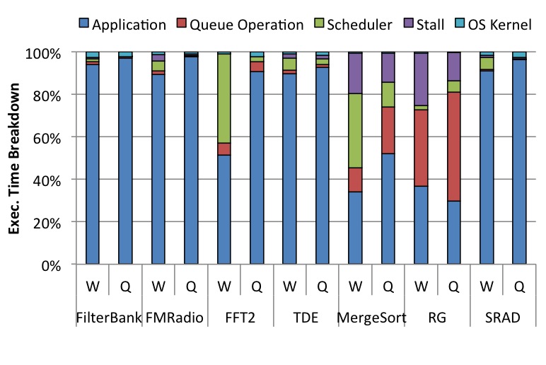
Random Work Stealing vs. QES
25.3x
28.9x
Random Work Stealing
Good scalability for compute intensive benchmarks
Bad scalability for memory intensive benchmarks
Large stall cycles → Larger scheduler and queue operation overhead
QES
Smaller stall cycles
MergeSort: 19% → 13.8%
RG: 24.8% → 13.3%
Thundering-herd problem
Queue operations of RG is rather increased.
(a) Random Work Stealing
(b) QES
W: Random Work Stealing, Q: QES
Notes:
Random working stealing performs <CLICK> well for compute intensive benchmarks.
<CLICK> But it performs badly for memory intensive benchmarks while spending large amount of time to stall.
<CLICK> By replacing the random work stealing to QES, we can improve the scalability by reducing the stall cycles significantly.
In case of Recursive Gaussian or RG <CLICK>, QES reduces the stall cycles but queue operation time is rather increased.
That is because of the thundering-herd problem.

Slide 25


RG
Graph
Test Source
Recursive
Gaussian1
Transpose1
Recursive
Gaussian2
Transpose2
Test Sink
Stall
Cycles
Random
Work
Stealing
QES
Thundering herd problem
High degree of data parallelism
High contention on shared data structures, data queues and ready queues.
High likelihood of stall caused by ticket synchronization.
Notes:
To more deeply understand how each scheduling policy works, we visualized the scheduling results.
This graph shows the scheduling of the random working stealing for the Recursive Gaussian benchmarks on 40 cores.
X-axis represents time and Y-axis represents each cores.
Each color means that the matched kernel is running.
The black color represents the stall cycles.
<CLICK> By replacing random work stealing to QES, the scheduling results is changed like this.
It obviously shows that QES can improve performance by reducing the execution time.
<CLICK> One interesting thing is that almost all threads start to stall at the same time.
It shows the scheduling under the thundering-herd problem.

Slide 26
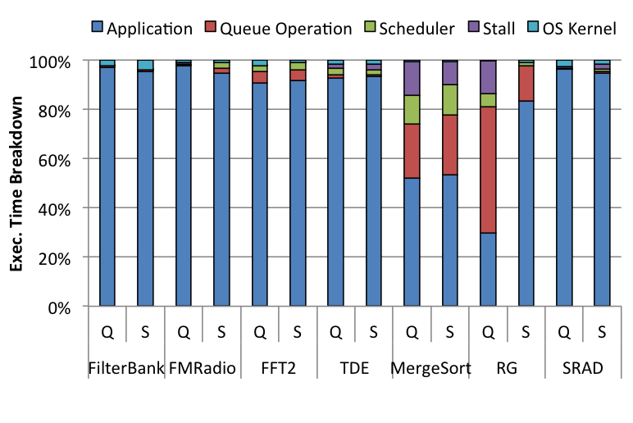
QES vs. QES + PSS
28.9x
30.8x
QES + PSS
PSS effectively avoids the thundering-herd problem.
Reduces the fractions of queue operation and stall cycle.
RG: Queue ops: 51% → 14%, Stall: 13.3% → 0.03%
Marginal performance improvement of MergeSort:
Short pipeline → little opportunity for pipeline parallelism
(b) QES
(c) QES + PSS
Q: QES, S: PSS
Notes:
By adopting PSS in addition to QES, <CLICK> we can improve the scalability of Recursive Gaussian significantly by drastically reducing the stall cycles caused by the thundering herd problem.
<CLICK> But the performance improvement of merge sort is marginal.
Because of the short pipeline, there is little opportunity to exploit pipeline parallelism.

Slide 27
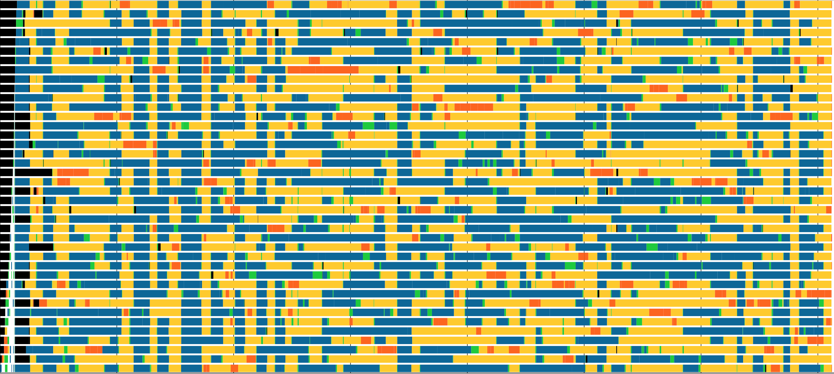
RG
Graph
Test Source
Recursive
Gaussian1
Transpose1
Recursive
Gaussian2
Transpose2
Test Sink
Stall
Cycles
Random
Work
Stealing
QES
QES + PSS
Notes:
Again, let’s check how PSS behaves.
As you can see, the black portions which were in QES scheduling are almost gone.
It means PSS successfully avoids the thundering-herd problem.

Slide 28
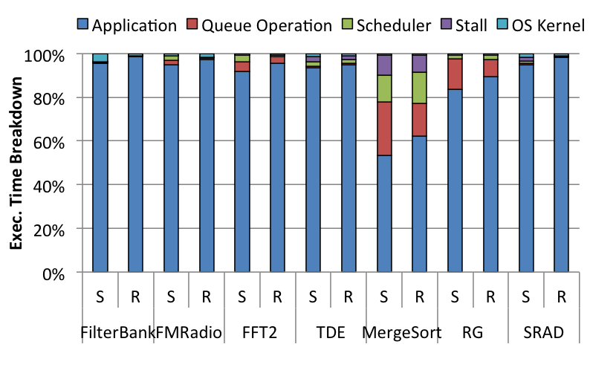
QES + PSS vs. QES + PSS + PRS
30.8x
33.7x
QES + PSS + PRS
Data dependent control flow
MergeSort: 19.2x → 23x
Memory Intensive benchmarks: NUMA/shared cache
TDE: 23.6 → 30.2x
FFT2: 30.5 → 34.6x
(c) QES + PSS
(d) QES + PSS + PRS
S: PSS, R: PRS
Notes:
By adopting PRS in addition to QES and PSS, we can improve scalability of merge sort which has data dependent control flow.
<CLICK> And performance of memory intensive benchmarks are also increased.
These results show that our PRS policy is effective to deal with fine grained load imbalance incurred by data dependent control flow and architectural variability.

Slide 29
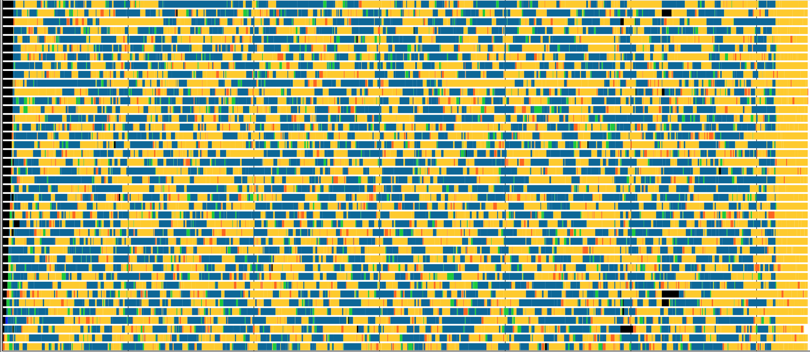
RG
Graph
Test Source
Recursive
Gaussian1
Transpose1
Recursive
Gaussian2
Transpose2
Test Sink
Stall
Cycles
Random
Work
Stealing
QES
QES + PSS
QES + PSS + PRS
Notes:
The final scheduling of Recursive Gaussian using all three policies is like this.

Slide 30
Comparison with StreamIt
35.6x
12.8x
< DANBI: QES+PSS+PRS >
< Other Runtimes >
Latest StreamIt code with highest optimization option
Latest MIT SVN Repo. , SMP backend (-O2), gcc (-O3)
No runtime scheduling overhead
But, suboptimal schedules incurred by inaccurate performance estimation result in large stall cycles.
Stall cycle at 40-core
StreamIt vs. DANBI = 55% vs. 2.3%
Notes:
From this, I will compare the DANBI with StreamIt, Cilk and OpenCL runtimes for original version of benchmarks.
In case of StreamIt, due to load imbalance induced by static scheduling, 55% of the execution time is spent for stalling.
Whearas in DANBI only 2.3% of execution time is spent for stalling.
As a result, the scalability of DANBI is 35.6x and the scalability of StreamIt is 12.8x.

Slide 31
Comparison with Cilk
23.0x
11.5x
< DANBI: QES+PSS+PRS >
< Other Runtimes >
Intel Cilk Plus Runtime
In small number of cores, Cilk outperforms DANBI.
One additional memory copy in DANBI for rearranging data for parallel merging has the overhead.
The scalability is saturated at 10 cores and starts to degrade at 20 cores.
Contention on work stealing causes disproportional growth of OS kernel time since Cilk scheduler voluntarily sleeps when it fails to steal a work from victim’s queue.
10 : 20 : 30 : 40 cores = 57.7% : 72.8% : 83.1% : 88.7%
Notes:
In Cilk, 88.7% of its execution time on 40 cores is spent in its work stealing scheduler.
In result, the scalability of merge sort in Cilk on 40 cores are only 11.5x, whereas DANBI achieves 23x.
This shows the limitation of topology unaware work stealing.

Slide 32
Comparison with OpenCL
35.5x
14.4x
< DANBI: QES+PSS+PRS >
< Other Runtimes >
Intel OpenCL Runtime
As core count increases, the fraction of runtime rapidly increases.
More than 50% of the runtime was spent in the work stealing scheduler of TBB, which is an underlying framework of Intel OpenCL runtime.
Notes:
Finally, OpenCL runtime also spent more than half of the execution time in its work stealing scheduler.
As a result, the relative speedup on 40 cores is just 14.4x whereas DANBI achieves 35.5x for the same applications.
The results of Cilk and OpenCL show that exploiting producer-consumer relationships is very important for efficient dynamic scheduling.

Slide 33
Outline
Introduction
DANBI Programming Model
DANBI Runtime
Evaluation
Conclusion

Slide 34
Conclusion
DANBI Programming Model
Irregular stream programs
Dynamic input/output rates
A cyclic graph with feedback data queues
Ticket synchronization for data ordering
DANBI Runtime
Dynamic Load-balancing Scheduling
QES: use producer-consumer relationships
PSS: prefer pipeline parallelism than data parallelism to avoid the thundering herd problem
PRS: to cope with fine grained load-imbalance
Evaluation
Almost linear speedup up to 40 cores
Outperforms state-of-the-art parallel runtimes
StreamIt by 2.8x, Cilk by 2x, Intel OpenCL by 2.5x
Notes:
To conclude, I’d like to point out that DANBI extends the streaming programming from static scheduling of regular programs to dynamic scheduling of irregular programs.
Especially, we proposed three dynamic scheduling polices,
QES which exploits producer-consumer relationships in stream graph,
PSS which is designed to avoid the thundering-herd problem,
and PRS which is designed to cope with fine grained load imbalance incurred by architectural variability and data dependent control flow.
Our evaluation results show that DANBI achieves almost linear speedup up to 40 cores and outperforms other state-of-the-art parallel runtimes significantly.

Slide 35

Thank you! Questions?
DANBI
\ \ \
Notes:
This is the end of my talk.
Thank you very much.
I will take your questions.

